Slide 1

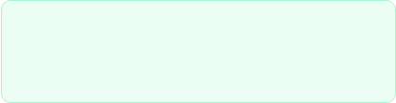
Benchmarking Lightweight CNNs for Real-Time Classification of Bangladeshi Mango Varieties on Edge Devices
Abdullah Nazmus-Sakib(210903) & Redwana Jahan (210879)
Supervised by: Professor Dr. Liton Jude Rozario
Department of CSE, Jahangirnagar University | Dec 2026
Notes:
Assalamu Alaikum.
Honorable Chairman, respected teachers, my supervisor Professor Dr. Liton Jude Rozario, and my dear friends, good morning.
Today we will present our undergraduate research project titled "Benchmarking Lightweight CNNs for Real-Time Classification of Bangladeshi Mango Varieties on Edge Devices.”
I am Abdullah Nazmus Sakib, and I am presenting this work together with my co-researcher Redwana Jahan from the Department of CSE, Jahangirnagar University.

Slide 2


Presentation Outline
Part I: Foundations & Design
Part II: Implementation & Edge AI
• Background & Economic Context
• Dataset & Preprocessing Strategy
• Problem Statement & Research Gaps
• Unified CNN Benchmarking Pipeline
• Research Objectives & Contributions
• Model Evaluation & Trade-off Analysis
• Literature Review Highlights
• AmmChini AI Offline Mobile Deployment
Notes:
Here is the roadmap of our presentation.
In the first part, I will explain the background, problem, objectives, literature review, and research gap.
In the second part, I will discuss our dataset, methodology, model comparison, and the AmmChini AI mobile application.

Slide 3
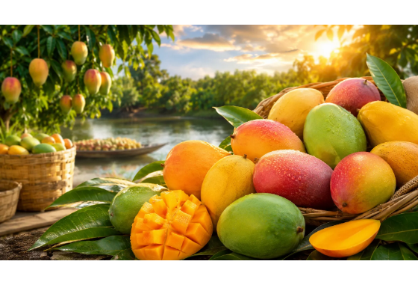
Research Background
Economic Importance: Mango (Mangifera indica L.) is a key agricultural driver in Bangladesh, especially across northern hubs like Rajshahi and Chapainawabganj.
Identification Challenge: Traditional visual sorting relies on human expertise, which is subjective, labor-intensive, and error-prone for morphologically similar varieties.
Paradigm Shift: Edge AI enables real-time, local machine intelligence directly on mobile hardware without requiring cloud connectivity.
Notes:
Mango is one of the most important fruits in Bangladesh.
It is especially valuable in Rajshahi and Chapainawabganj.
Today, people identify mango varieties by looking at them.
This takes time and can be wrong because some varieties look very similar.
Edge AI can solve this by running the model directly on a smartphone without internet.

Slide 4
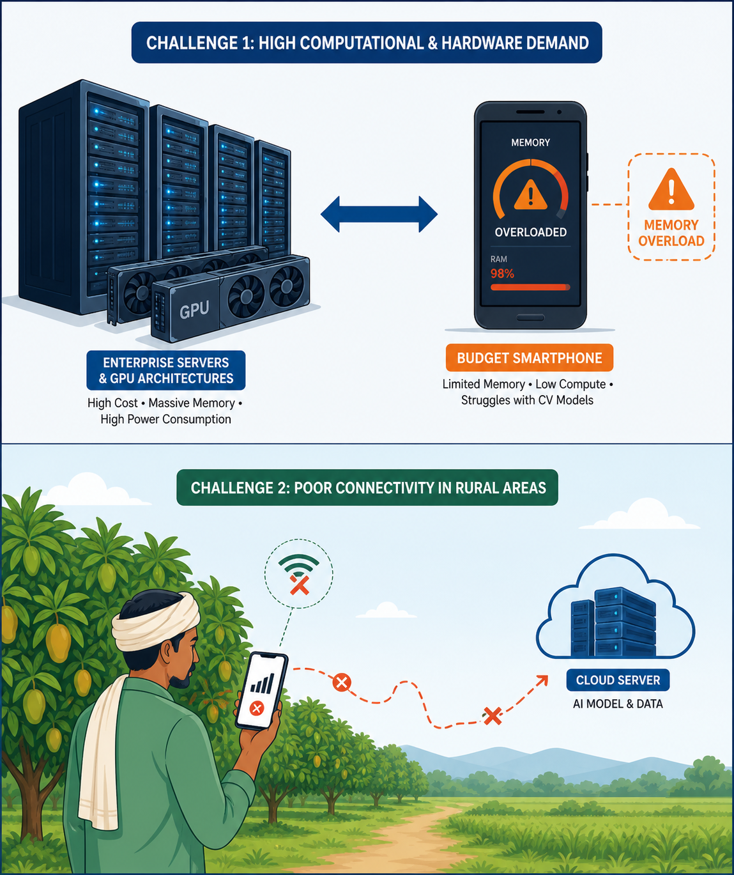
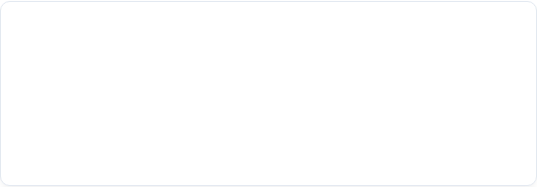
Problem Statement
1. Heavy Model Mismatch
State-of-the-art CNNs (ResNet, DenseNet, ViTs) require heavy GPU compute and memory, making direct deployment on commodity smartphones in rural areas unfeasible.
2. High Cloud Reliance
Cloud-based classification suffers from latency, communication cost, and network instability in remote farming orchards where internet coverage is unreliable.
Notes:
Our research focuses on two main problem.
1. High-accuracy AI models usually need powerful computers.
Farmers and traders do not have those devices.
2. Another problem is cloud-based systems.
They need internet, which is not always available in rural areas.
So, we need a lightweight and offline solution.

Slide 5





Key Research Objectives
1. Benchmark CNNs
2. TFLite Optimization
3. AmmChini AI App
Evaluate 5 lightweight architectures under identical protocols for accuracy, size, and latency.
Optimize chosen candidate via Float16 post-training quantization to reduce storage and footprint.
Develop a Flutter Android app for 100% offline, real-time mango variety classification.
Notes:
We had three main objectives.
First, compare five lightweight CNN models under the same conditions.
Second, optimize the best model using TensorFlow Lite Float16.
Third, build the AmmChini AI Android app that works completely offline.

Slide 6

Literature Review Summary
Study | Focus / Architecture | Dataset | Key Limitation
Salazar-Campose (2025) | 'Kent' Mango Maturity / Deep CNN | International Cultivars | No edge latency evaluation
Wu et al. (2025) | Aiwen Grading / Mobile CNN | Single Class Grading | Cloud-dependent backend
Howard et al. (2019) | MobileNetV3 NAS Architecture | ImageNet-1K Benchmark | Generic vision, no local agro data
Islam et al. (2021) | Shallow CNN Classification | Local Mango Varieties | No mobile deployment testing
Our work addresses all four limitations.
Notes:
We reviewed several previous studies.
Most studies focused on international mango varieties.
Some depended on cloud servers.
Others did not test mobile deployment.
These limitations showed that there is still room for a practical Edge AI solution for Bangladesh.
Color-code the limitation column.
Paper <------------→Limitation
Salazar -------------> 🔴 No Edge AI
Wu-----------------→🔴 Cloud
Howard-----------→🟡 Generic
Islam-------------→🔴 No deployment

Slide 7


Research Gap & Contribution
Identified Research Gap
Proposed Contribution
• Focus solely on laboratory accuracy while ignoring model size and latency.
• Systematic evaluation of 5 lightweight CNN backbones on 10 native varieties.
• Lack of systematic benchmarking under identical preprocessing conditions.
• Dynamic pipeline ensuring architecture-specific tensor normalization.
• Absence of end-to-end deployable mobile frameworks for local Bangladeshi varieties.
• Production-ready Flutter app delivering fully offline inference on Android.
Notes:
Previous research mainly focused on accuracy.
They often ignored model size and speed.
Many studies also lacked fair benchmarking and offline deployment.
Our contribution is different.
We compared five models, measured both accuracy and latency, and deployed the best model in a Flutter app.
Gap:
Accuracy only focus
No benchmarking
No deployment
Contribution:
5-model benchmark
Latency evalution
Offline-flutter app

Slide 8
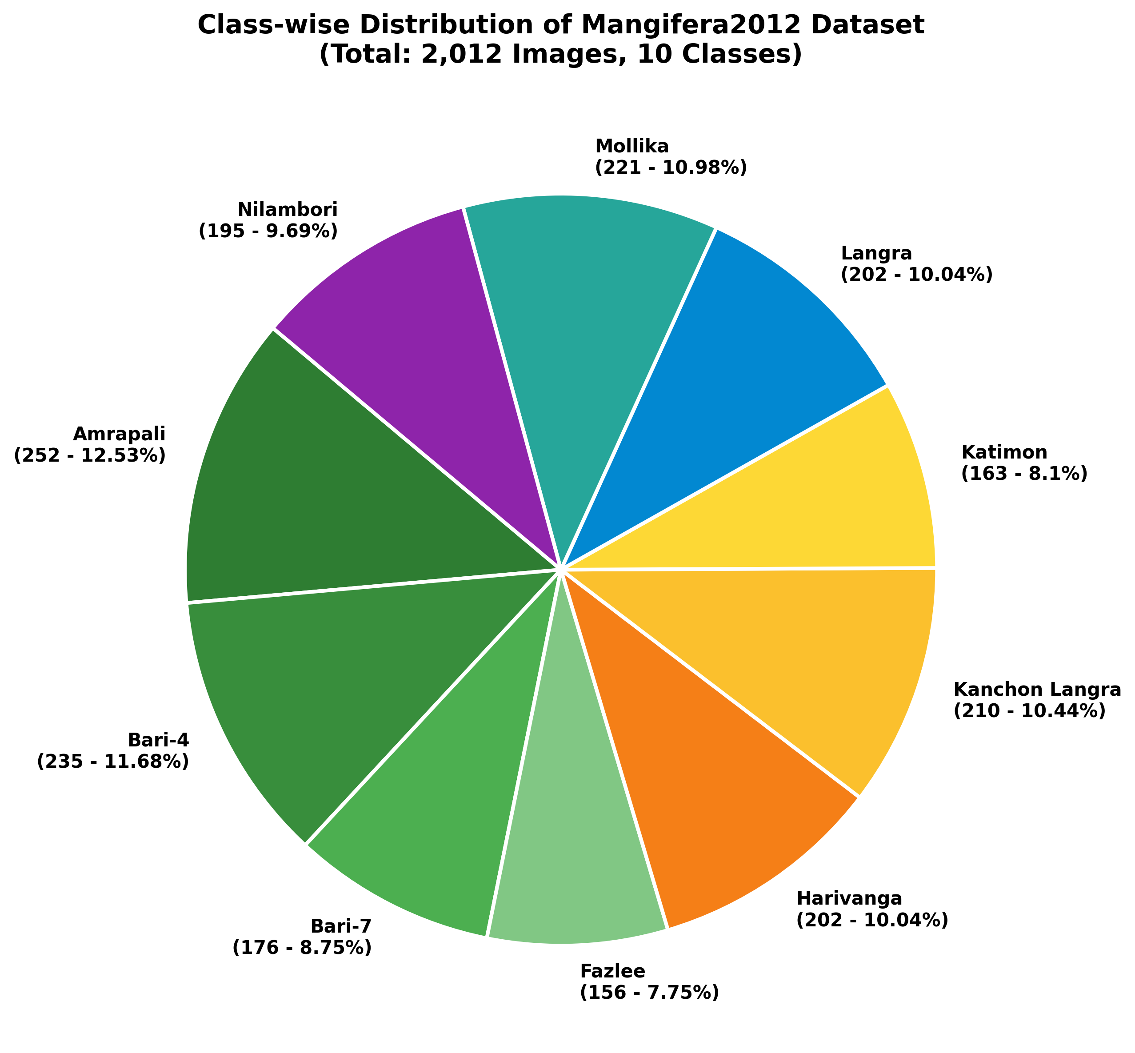
Mangifera2012 Dataset Details
Class ID | Mango Variety (Cultivar) | Sample Count | Dataset Share (%)
1 | Amrapali | 252 | 12.53%
2 | Bari-4 | 235 | 11.68%
3 | Fazlee | 156 | 7.75%
4 | Harivanga | 202 | 10.04%
5 | Kanchon Langra & Langra | 412 | 20.48%
6 | Other Native Types (Bari-7, Katimon, Mollika, Nilambori) | 755 | 37.52%
Total | 10 Indigenous Classes | 2,012 Images | 100.0%
Notes:
We used the public Mangifera2012 dataset.
It contains 2,012 images of 10 Bangladeshi mango varieties.
Before training, we resized all images and applied preprocessing and data augmentation.
This helped the models learn better and reduced overfitting.

Slide 9
End-to-End Methodological Pipeline
2. Transfer Learning
4. Edge Deployment
Frozen ImageNet backbones trained with custom GAP + Dense classification head.
TFLite Float16 quantization & Flutter integration for AmmChini AI app.
1. Data Prep
3. Benchmarking
Image resizing (224x224), dynamic normalization & online data augmentation.
Multi-objective analysis of accuracy, F1-score, size, and mobile latency.
Notes:
Our methodology has four steps.
First, prepare and preprocess the images.
Second, train five transfer learning models.
Third, compare them using accuracy, F1-score, model size, and latency.
Finally, optimize the best model and deploy it in our Flutter application.

Slide 10
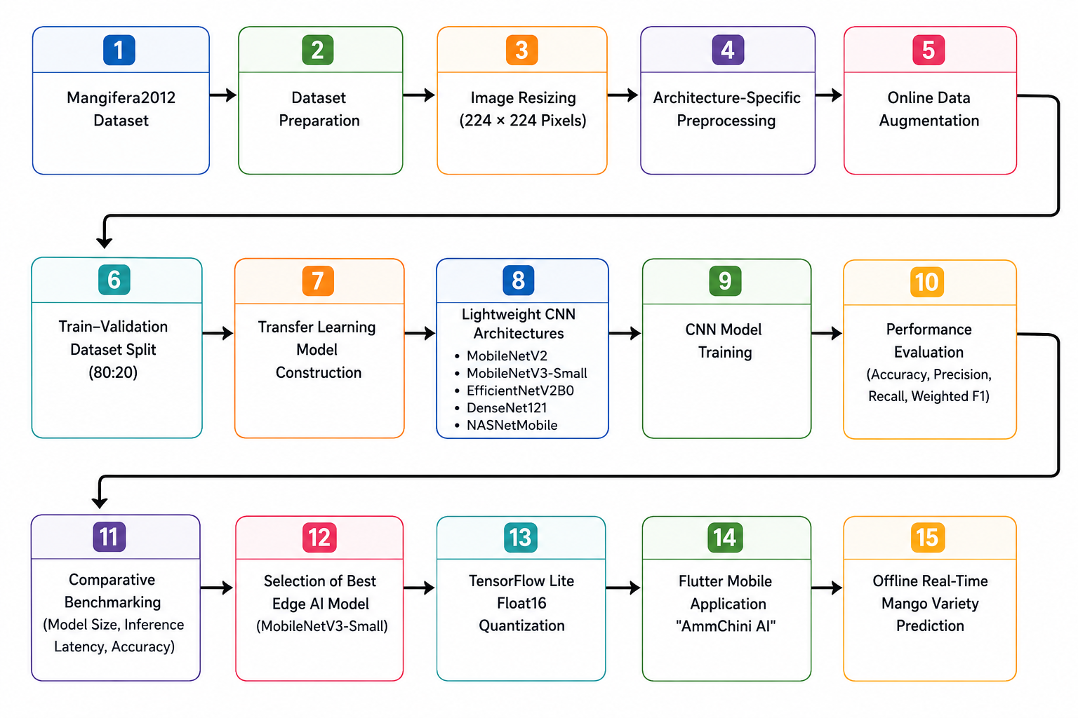
Methodology Workflow
Notes:
This slide shows our complete workflow.
In the first row, we prepare the dataset by resizing images, applying preprocessing, and using data augmentation.
In the second row, we train five CNN models using transfer learning and evaluate their performance.
In the final row, we compare the models.
MobileNetV3-Small gives the best balance between accuracy and speed.
Then we convert it into TensorFlow Lite and deploy it inside AmmChini AI for offline prediction.
Speaker Note (1–1.5 minutes)
"This figure illustrates the complete workflow of our methodology, starting from dataset preparation and ending with offline real-time mango variety prediction.”
Row 1 – Data Preparation
"In the first row, we begin with the Mangifera2012 dataset, which contains images of different mango varieties. We prepare and clean the dataset, resize all images to 224 by 224 pixels, apply architecture-specific preprocessing for each CNN model, and perform online data augmentation to increase data diversity and improve model generalization.”
Row 2 – Model Development
"The second row focuses on model development. We split the dataset into 80 percent for training and 20 percent for validation. Then, we construct transfer learning models using five lightweight CNN architectures: MobileNetV2, MobileNetV3-Small, EfficientNetV2B0, DenseNet121, and NASNetMobile. After training, we evaluate each model using Accuracy, Precision, Recall, and Weighted F1-score.”
Row 3 – Edge AI Deployment
"In the final row, we compare the models based on accuracy, model size, and inference latency to identify the best edge AI model. MobileNetV3-Small achieved the best balance between performance and efficiency, so we selected it for deployment. We then applied TensorFlow Lite Float16 quantization, integrated the optimized model into our Flutter-based AmmChini AI application, and achieved offline real-time mango variety prediction on mobile devices.”
Closing Line
"This end-to-end pipeline demonstrates how a lightweight deep learning model can be optimized for practical edge AI deployment in agriculture without requiring an internet connection."

Slide 11



Evaluated CNN Backbones
MobileNet V2/V3
EfficientNetV2B0
DenseNet / NASNet
Inverted residual blocks, depthwise separable convolutions & Hard-Swish activation.
Fused-MBConv layers and compound scaling for enhanced feature extraction efficiency.
Dense feature concatenation and neural architecture search blocks for comparative analysis.
Notes:
We selected five lightweight CNN models.
MobileNetV2 and MobileNetV3 are designed for mobile devices.
EfficientNetV2 focuses on higher accuracy.
DenseNet121 improves feature reuse.
NASNetMobile uses neural architecture search.
Using different architectures helps us make a fair comparison.

Slide 12
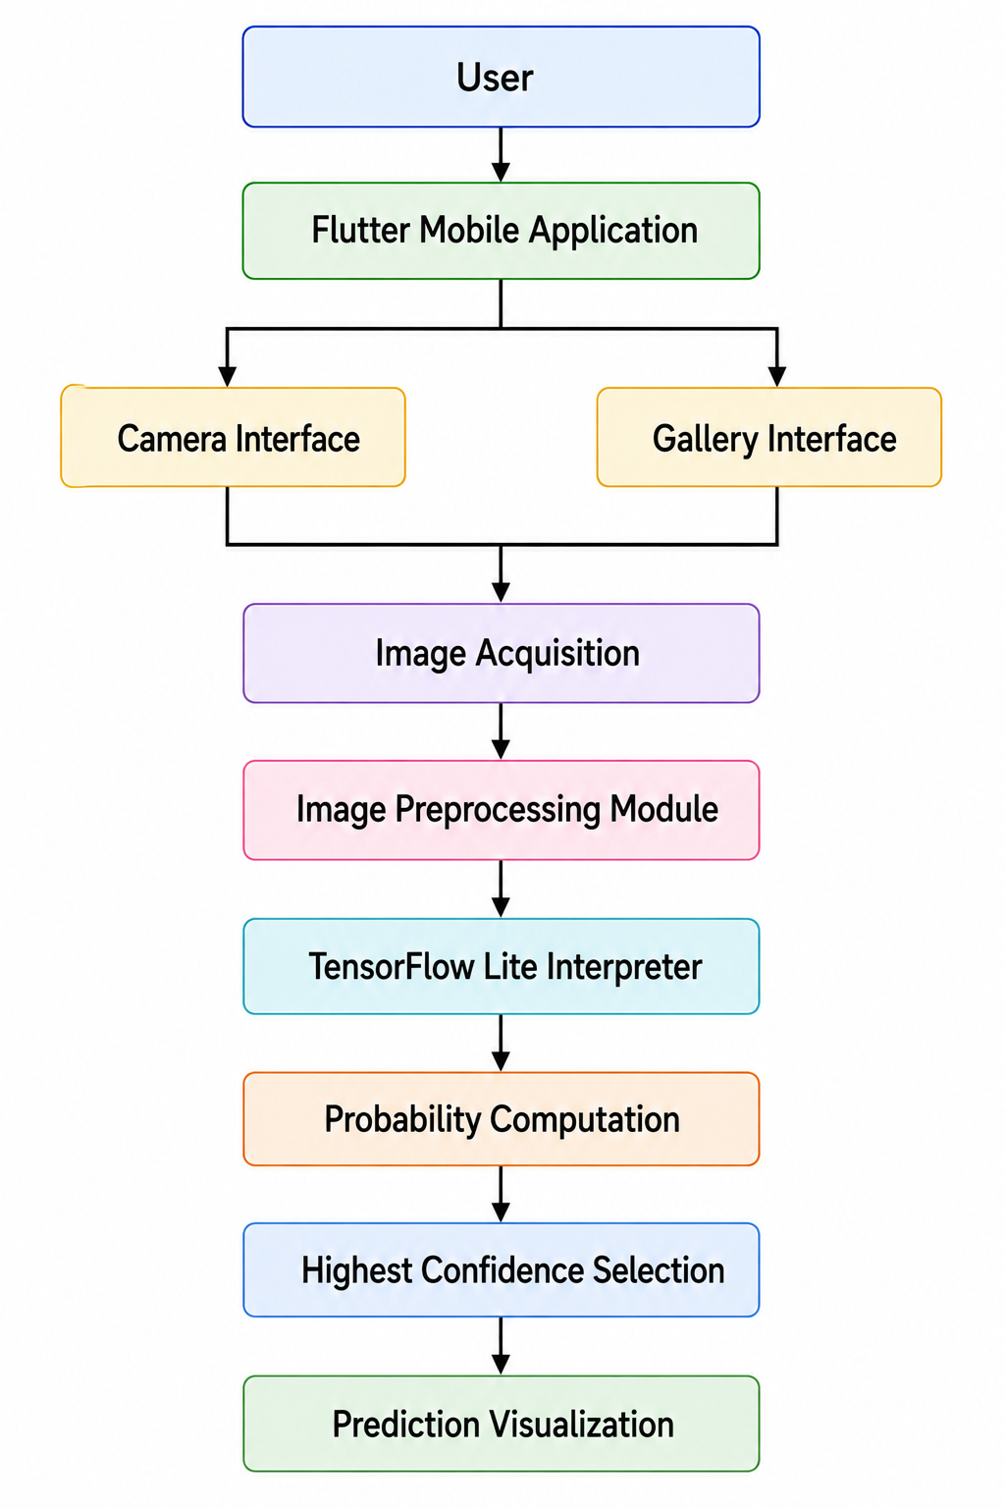
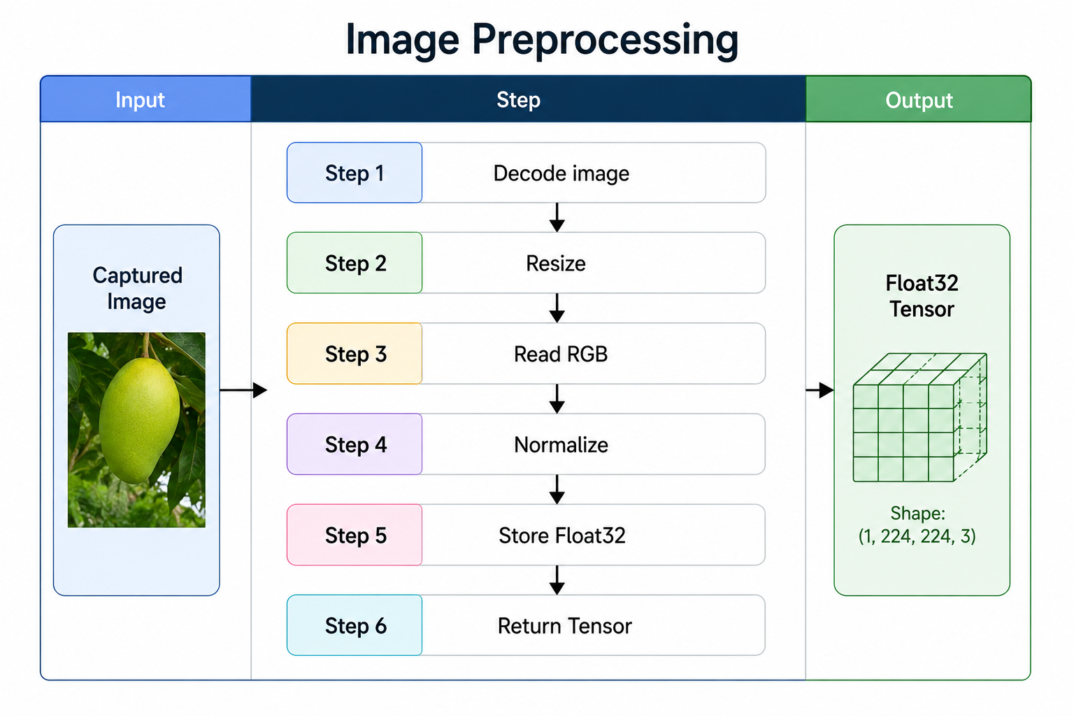
Edge Mobile System Setup
Cross-Platform Flutter Architecture
The application captures camera frames or gallery images, decodes RGB pixels into flat Float32 ByteBuffers, and passes tensors directly to local TFLite interpreters.
This bypasses external API calls completely, achieving zero network dependency and low execution latency in field conditions.
Notes:
Our mobile application is built with Flutter.
The user can take a photo or choose one from the gallery.
The image is converted into a tensor and sent directly to the TensorFlow Lite interpreter.
Everything happens inside the phone.
No internet or server is needed.

Slide 13
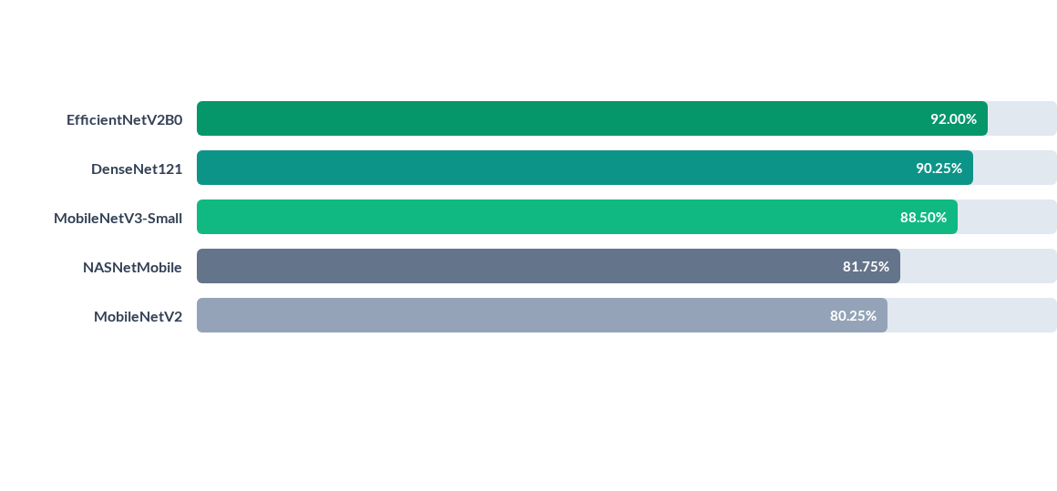
Accuracy Performance Benchmarking
EfficientNetV2B0 achieved peak accuracy (92.00%), followed closely by DenseNet121 and MobileNetV3-Small.
Notes:
Looking only at accuracy, EfficientNetV2B0 performs the best with 92%.
DenseNet121 comes next.
MobileNetV3-Small achieves 88.5%.
But accuracy alone is not enough.
For Edge AI, speed and model size are also important.

Slide 14
Comprehensive Model Metrics
Model Name | Accuracy | Precision | Weighted F1 | Model Size | Inference Latency
MobileNetV2 | 80.25% | 80.92% | 80.33% | 11.07 MB | 34.66 ms
MobileNetV3-Small | 88.50% | 88.60% | 88.27% | 4.99 MB | 28.29 ms
EfficientNetV2B0 | 92.00% | 92.08% | 92.00% | 24.39 MB | 40.26 ms
NASNetMobile | 81.75% | 81.78% | 81.28% | 20.48 MB | 41.37 ms
DenseNet121 | 90.25% | 90.54% | 90.18% | 29.82 MB | 68.46 ms
Notes:
This table shows all important metrics together.
EfficientNetV2 has the highest accuracy but it is much larger.
DenseNet121 also has higher latency.
MobileNetV3-Small is only 4.99 MB and runs in about 28 milliseconds.
This makes it the best choice for mobile deployment.

Slide 15
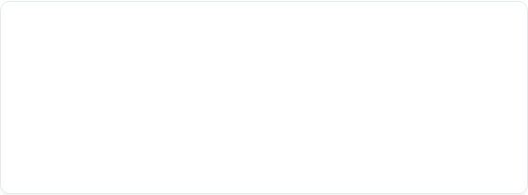
Edge Deployment Model Selection
Why Not EfficientNetV2B0?
Why MobileNetV3-Small Wins
• Highest accuracy (92.00%)
• Accuracy 88.50%
• But model size is 24.39 MB (5x larger).
• But Ultra-compact storage footprint of only 4.99 MB (Quantized).
• Higher latency (40.26 ms) increases battery drain and RAM overhead.
• Fastest inference speed of 28.29 ms
Notes:
This slide explains our final decision.
EfficientNetV2 is only about 3.5% more accurate.
But it is almost five times larger.
MobileNetV3-Small is much faster and uses less storage.
So it gives the best balance between performance and efficiency.

Slide 16
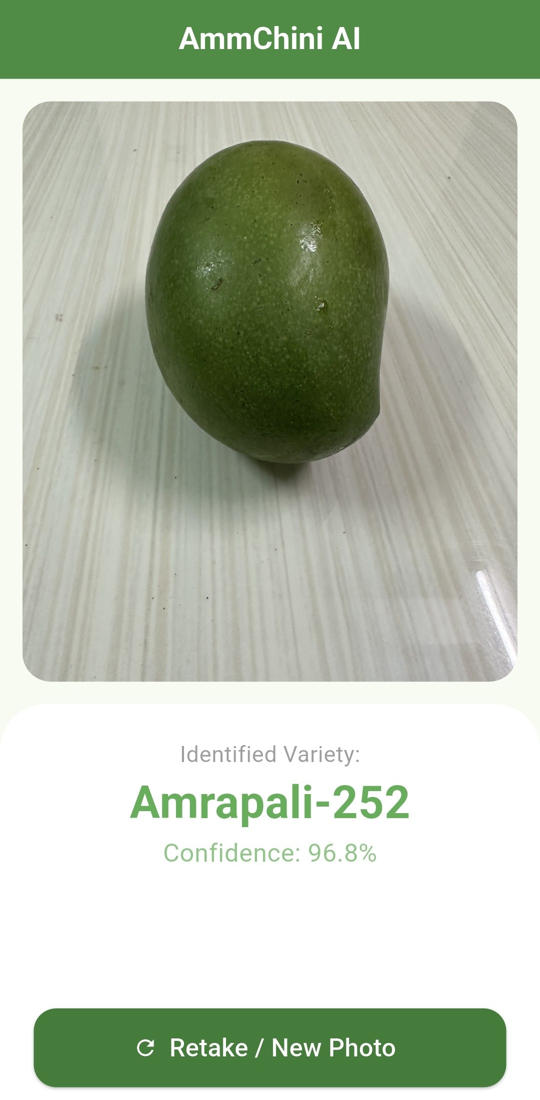
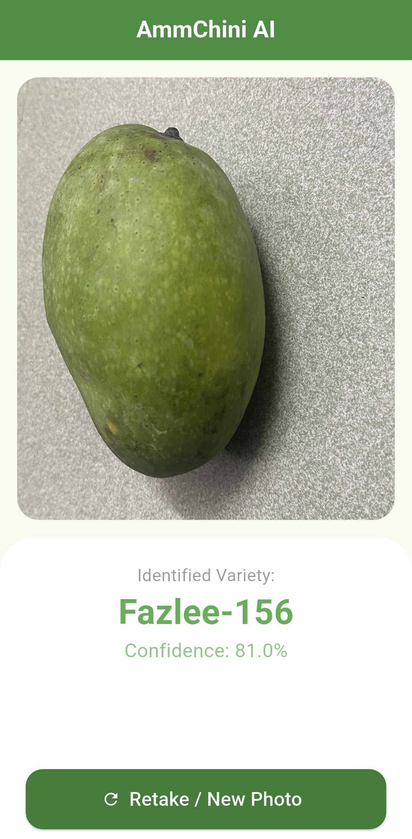
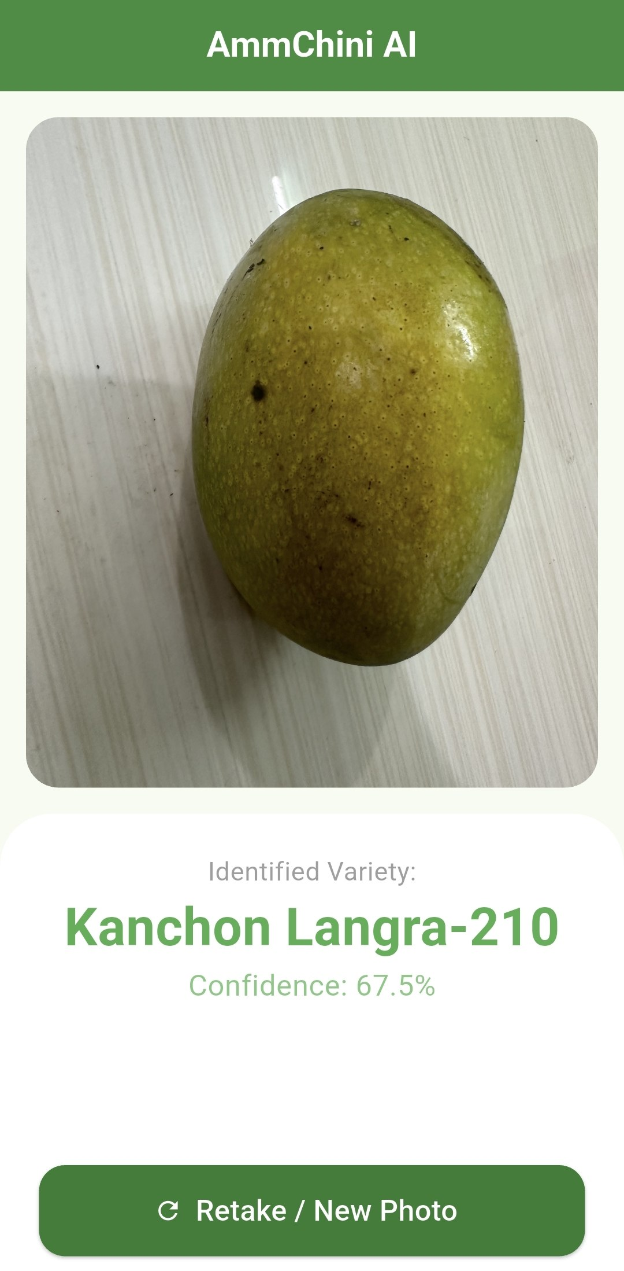


AmmChini AI Mobile Application
Key Features:
Real-Time Speed
100% Offline
Privacy First
Notes:
After selecting MobileNetV3-Small, we built the AmmChini AI application.
The app works completely offline.
It gives real-time predictions in less than one second.
User images stay inside the phone, so privacy is protected.

Slide 17

Optimized Deployment Performance
Before Quantization
9.98MB
FP 32
Float16 Post-Training Quantization
Through TensorFlow Lite Float16 quantization, MobileNetV3-Small achieved a 50% storage footprint reduction from FP32 baseline while preserving classification accuracy across all 10 native varieties.
Average on-device execution time was recorded at sub-30 milliseconds on commodity Android mobile CPUs.
4.99MB
Optimized Model Size
After Quantization
Notes:
We optimized the model using TensorFlow Lite Float16.
The model size became 4.99 MB, which is about 50% smaller than the original.
At the same time, prediction quality stayed almost the same.
The average execution time remained under 30 milliseconds.

Slide 18
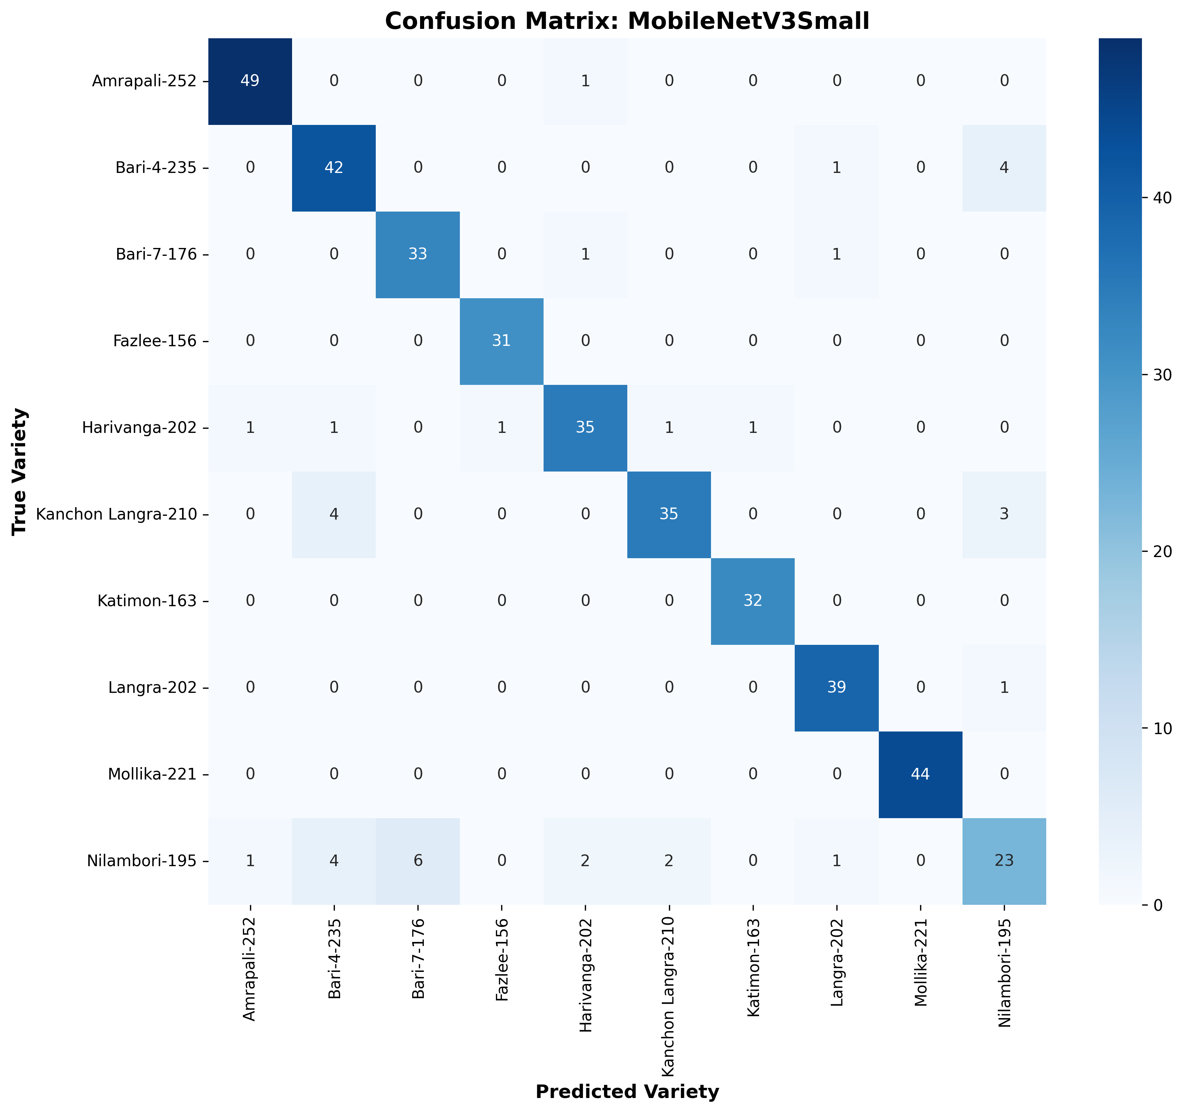
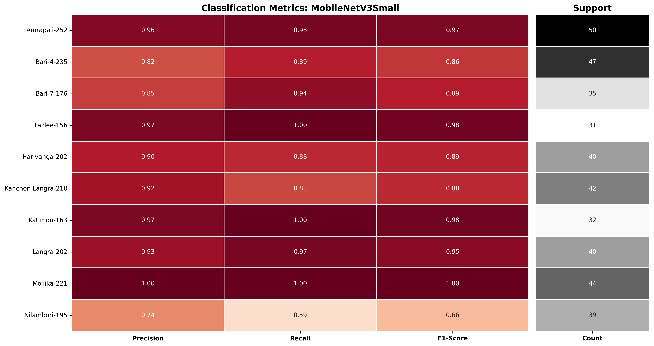
Error Analysis
The most frequent confusion occurred between Bari-4-235 ↔ Nilambori-195 and Kanchon Langra-210 ↔ Bari-4-235.
Reason: similar morphology.
Notes:
No model is perfect.
The biggest confusion happened between Bari-4 and Nilambori, and also between Kanchon Langra and Bari-4.
These varieties look very similar.
More training images can improve these results in the future.

Slide 19
Conclusion & Future Directions
Deployment Feasibility: Demonstrates that lightweight CNNs can bridge the gap between high-accuracy laboratory models and practical Edge AI field deployment.
Balanced Solution: MobileNetV3-Small offered the optimal trade-off between predictive accuracy (88.50%) and deployment efficiency (4.99 MB, 28.29 ms).
Future Expansion: Integrating YOLO object detection for multi-fruit orchard counting and automated ripeness/defect grading.
Hardware Optimization: Exploring Integer (INT8) quantization and neural network pruning for microcontrollers and IoT edge boards.
MobileNetV3-Small proved that practical Edge AI matters more than raw accuracy.
Notes:
To conclude, our research shows that lightweight CNN models can be successfully deployed on mobile phones.
MobileNetV3-Small gives the best balance between accuracy, model size, and speed.
In the future, we plan to add YOLO object detection, fruit ripeness detection, and INT8 optimization for smaller edge devices.
Our main message is simple:
For real-world mobile applications, practical deployment is more important than only achieving the highest accuracy.

Slide 20
Questions & Discussion
Thank you for your attention!
Notes:
"That concludes our presentation. We express our sincere gratitude to our supervisor Professor Dr. Liton Jude Rozario, the faculty members, and the honorable defense committee.
We are now open to your questions and valuable feedback.
Thank you very much!"

